Slide 1
Sentiment Review Analysis- NLP
Team members:
Mr.Buddharaju Srujan Varma
Mr.Prasanna Vilas Hedaoo
Mr. Tulasi Mohan Kandimalla.
G Karthikeya
Mr. Venugopal G
Miss.Jaya lakshmi Vuyyuru

Slide 2
INDEX
Problem Statement
Objective
Introduction
Importance
Applications of sentiment Analysis
Main goals
Data collection
Data pre-processing
Model training and evaluation
Deployment
Challenges and limitations
conclusion

Slide 3
Objective
1. Develop an NLP model that can accurately interpret and categorize emotions,
sentiments, and key thematic elements from customer reviews.
2. Generate actionable insights from review data that can inform product
improvements, marketing adjustments, and enhanced customer support.
3. Create a dashboard for ongoing monitoring of customer reviews that updates in real-
time and highlights trends, shifts in customer sentiment, and emerging issues.

Slide 4
Introduction
Definition:-Sentiment analysis is a technique used in natural language processing (NLP) to determine the emotional tone behind a body of text. It is used to identify and classify opinions expressed in text as positive, negative, or neutral.

Slide 5
Importance
Customer Insights: Helps businesses understand customer feelings and perceptions about their products or services.
Improvement Identification: Identifies areas where products or services need improvement based on customer sentiment.
Trend Analysis: Monitors trends over time to see how changes in products, services, or policies impact customer sentiment.
Competitive Advantage: Provides a competitive edge by allowing businesses to respond promptly to customer feedback and improve customer satisfaction.
Market Strategy: Informs marketing and product strategies by highlighting what customers like or dislike.

Slide 6
Applications of Sentiment Analysis
Product Reviews: Analyzing customer reviews on e-commerce platforms.
Social Media Monitoring: Tracking brand mentions and sentiments on social media platforms.
Customer Support: Understanding the tone of customer service interactions to improve support quality.
Market Research: Gaining insights into consumer opinions and market trends.

Slide 7
Main Goals of the Project
1. Analyze Customer Reviews to Determine Sentiment**
Use sentiment analysis techniques to categorize customer reviews into positive, negative, and neutral sentiments.
Understanding the overall sentiment can help gauge customer satisfaction and identify any major issues with products or services.
2. Use Sentiment Analysis to Improve Product/Service Offerings**
Leverage insights gained from sentiment analysis to make data-driven decisions for product and service enhancements.
Addressing customer feedback directly can lead to higher customer satisfaction and loyalty, driving business growth.
3. Identify Common Themes and Areas for Improvement**
Extract and analyze recurring themes within the reviews to pinpoint specific aspects that customers frequently mention, whether positive or negative.
-Recognizing common themes helps in understanding the strengths and weaknesses of the product or service, guiding targeted improvements.

Slide 8
Data Collection
Amazon: Customer reviews on various products such as electronics, books, household items, etc.
We collect the data from amazon reviews and

Slide 9
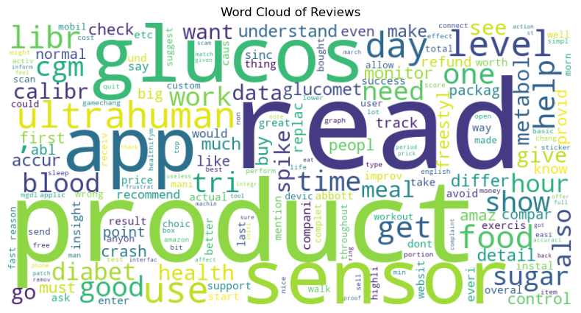

Slide 10
Data Preprocessing
1. Text Cleaning:Remove noise and irrelevant information to ensure the quality and consistency of the text data.
Remove punctuation, numbers, and special characters.
Convert text to lowercase to maintain uniformity.
Strip extra whitespace.
2.Tokenization: Break down the text into individual words or tokens, which are the basic units for further processing.
Split the cleaned text into words.
Handle contractions

Slide 11
Data preprocessing
3. Removing Stopwords:Eliminate common words that do not contribute much to the meaning of the text, such as "and," "is," "in."
Use a predefined list of stopwords (e.g., NLTK stopwords list).
Customize the list if necessary to include/exclude certain words.
4. Lemmatization/Stemming:Reduce words to their base or root form to ensure that different forms of a word are treated the same.
Lemmatization: Convert words to their dictionary form (e.g., "running" to "run").
Stemming: Reduce words to their root form (e.g., "running" to "run"), though this may sometimes lead to non-dictionary words.
5.Vectorization:Convert the cleaned and processed text into numerical representation that machine learning models can understand

Slide 12
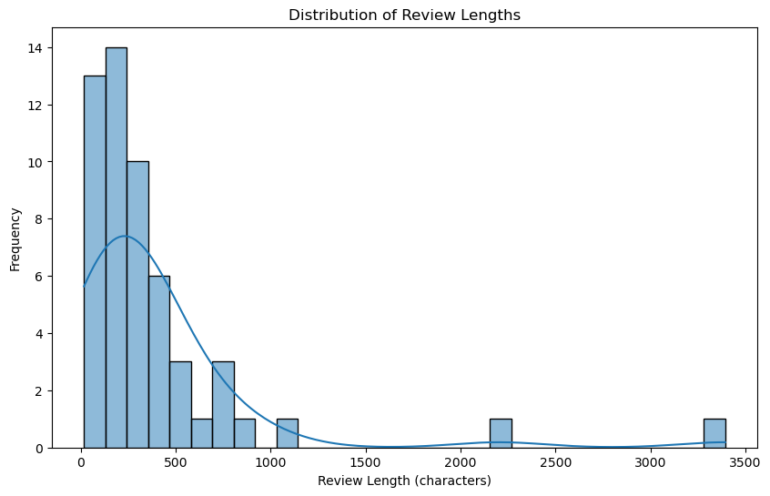

Slide 13
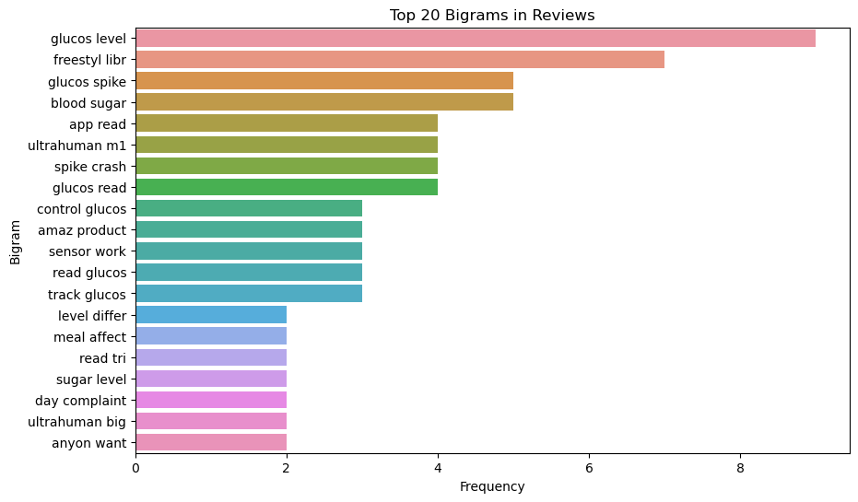

Slide 14
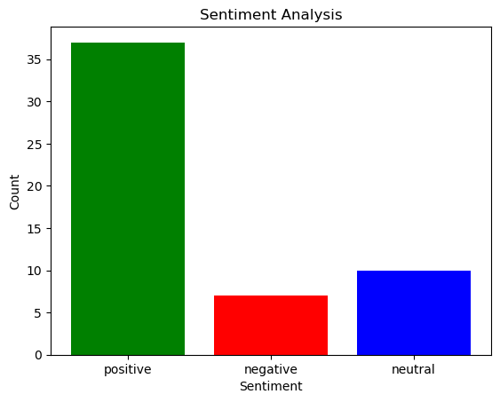

Slide 15
Model Training and Evaluation
Training the Model Size: The dataset consists of 10,000 customer reviews, split into 8,000 for training and 2,000 for testing.
Features Used:
Text features: Word counts, TF-IDF scores, word embeddings.
Metadata features: Review rating, length of the review, etc.
Models Implemented:
Naive Bayes: Known for its simplicity and effectiveness in text classification tasks.
Support Vector Machine (SVM): Effective for high-dimensional spaces and commonly used for text classification.
Logistic Regression: A simple and widely used linear model for binary and multi-class classification.
Random Forest: An ensemble method that improves classification accuracy by averaging multiple decision trees.
Deep Learning Models: Such as LSTM (Long Short-Term Memory) for handling sequential data.
Knn model:Calculate the distance between the new data point and all other data points in the training set.
Decision tree:Select the best feature to split the data based on a chosen criterion

Slide 16
Model Training and Evaluation
Evaluation Metrics
Accuracy: The ratio of correctly predicted instances to the total instances.
Precision:The ratio of correctly predicted positive observations to the total predicted positives.
Recall:The ratio of correctly predicted positive observations to all the actual positives.
F1 Score:The harmonic mean of precision and recall.
Confusion Matrix:A table that describes the performance of a classification model.
ROC Curve :A graphical plot that illustrates the diagnostic ability of a binary classifier.
AUC:Measures the entire two-dimensional area underneath the ROC curve. A higher AUC indicates better model performance.

Slide 17
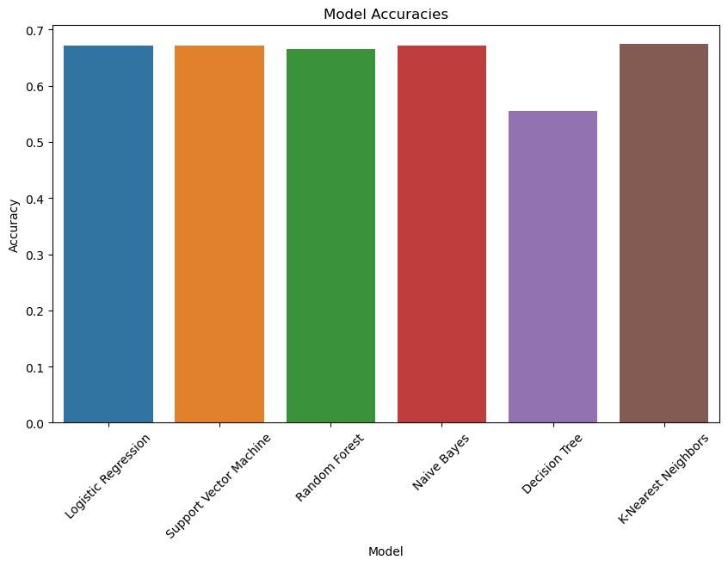

Slide 18
Model Training and Evaluation
Model Validation
Cross-Validation:A technique for assessing how the results of a statistical analysis will generalize to an independent dataset.
Method: K-Fold Cross-Validation where the dataset is divided into K subsets, and the model is trained and validated K times, each time using a different subset as the validation data and the remaining K-1 subsets as training data.
Hyperparameter Tuning:The process of optimizing the hyperparameters of a model to improve its performance.
Grid Search: Exhaustive search over a specified parameter grid.
Random Search: Randomly sampling the parameter space.
Bayesian Optimization: Using probabilistic models to find the optimal hyperparameters.

Slide 19
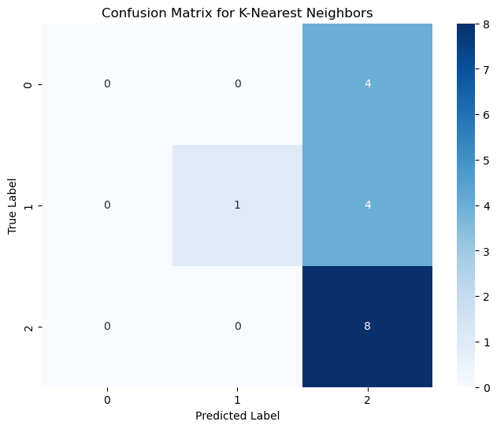

Slide 20
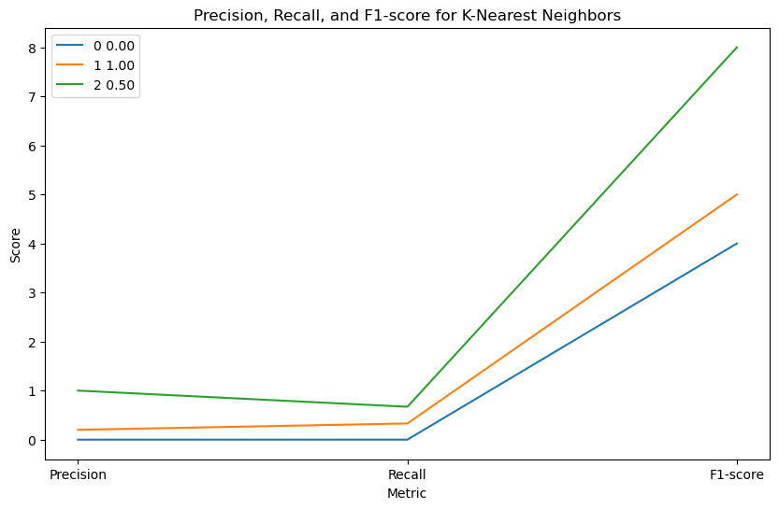

Slide 21
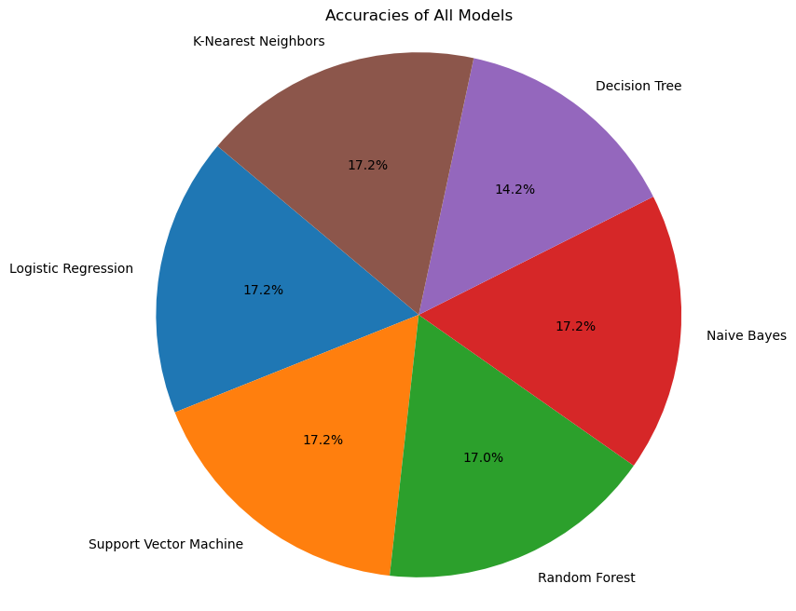

Slide 22
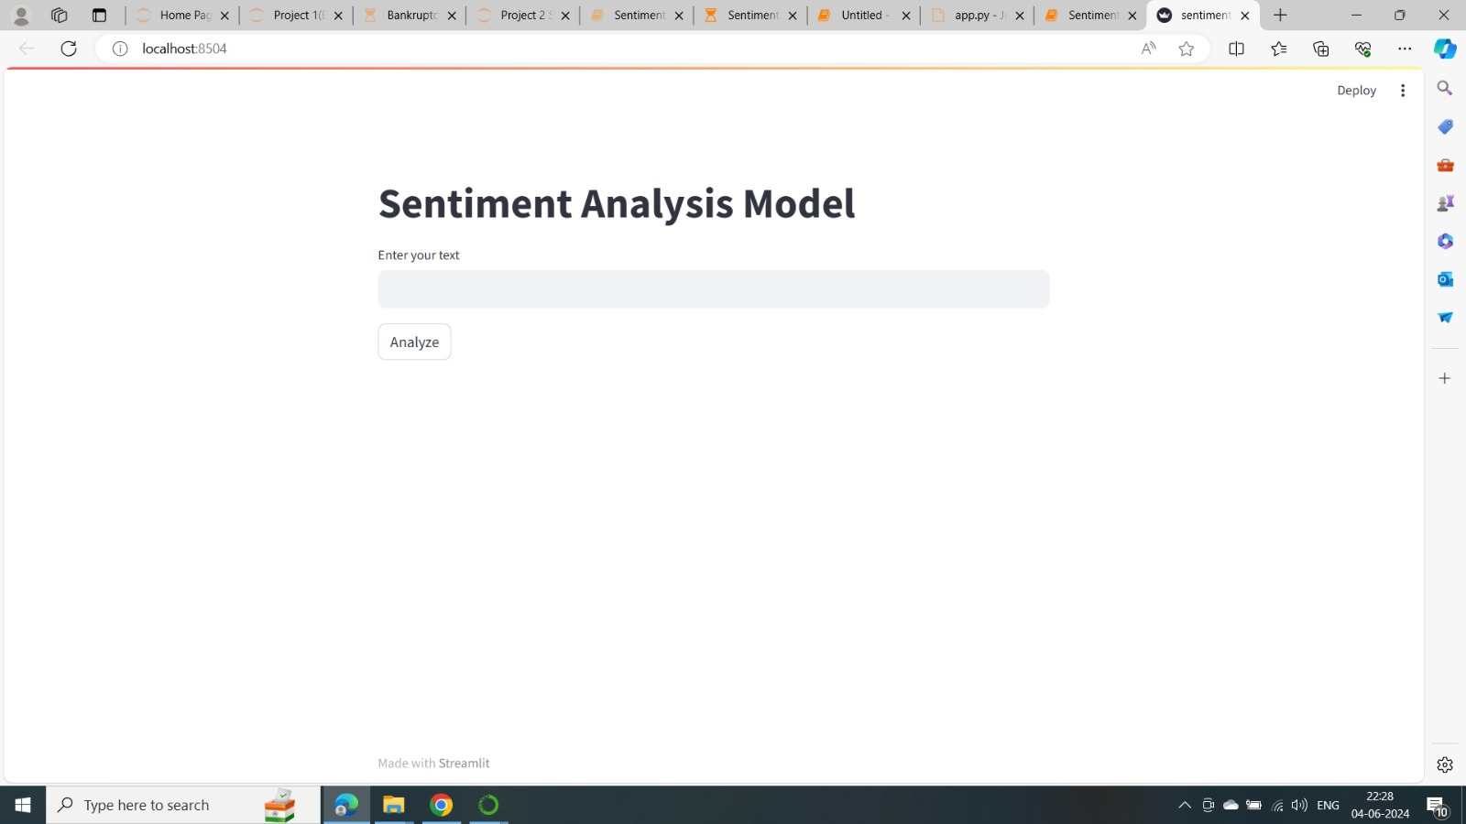
Deployment

Slide 23
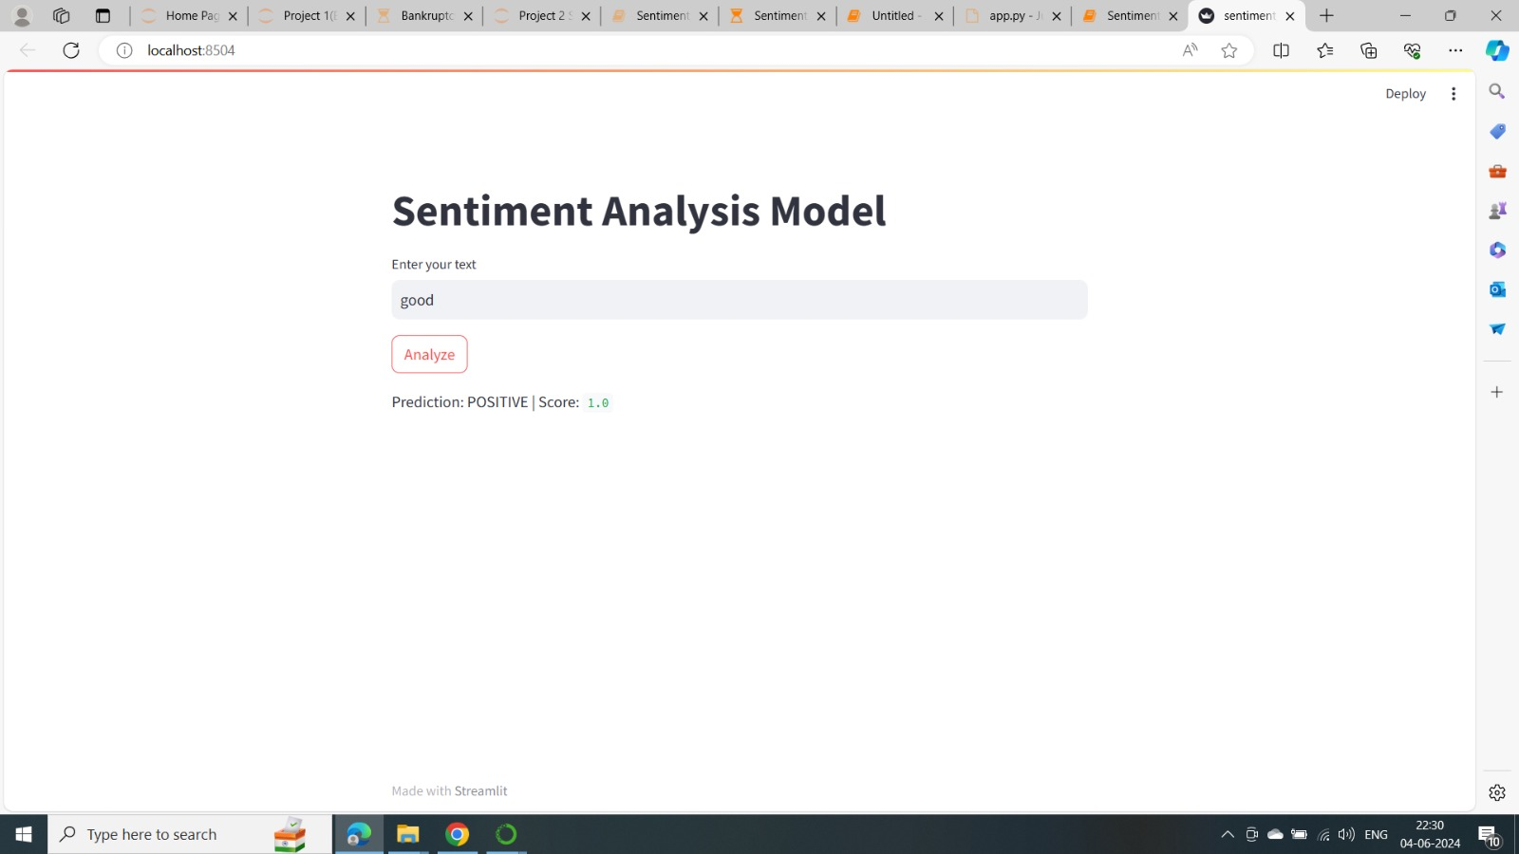

Slide 24


Slide 25
Challenges and Limitations
Potential Issues:
Data quality: Noise and irrelevant data.
Model accuracy: Misclassification of sentiments.
Sentiment misclassification: Difficulty in understanding context.

Slide 26
Conclusion
In this project, we explored the application of sentiment analysis techniques to analyze customer reviews and derive valuable insights for business decision-making.
We employed various machine learning models, including K-Nearest Neighbors (KNN) and Decision Trees, to classify customer sentiments into positive, negative, or neutral categories.
Through rigorous data preprocessing, model training, and evaluation, we gained a deep understanding of customer sentiments expressed in text data.
We leveraged the power of natural language processing (NLP) techniques to extract meaningful features from the reviews, enabling our models to accurately classify sentiments.
In conclusion, sentiment analysis is a powerful tool for unlocking valuable insights from customer feedback, empowering businesses to make data-driven decisions and foster long-term relationships with their customers.

Slide 27


